Slide 1
Registration is changing

Slide 2
What’s changing?
Structure of the Register
Timescales for registration
Continuous registration and the annual declaration
Public Register search
Codes of Practice
New CPL requirements
Qualification timescales
Return to practice for social workers
More flexible qualifications

Slide 3
Structure of the Register

Slide 4
Four new Register parts replace current 23
Social workers
Social work students
Social care workforce
Children and young people workforce

Slide 5
New levels of job role
Non-care service | Residential childcare | School care accommodation | Day care of children | Care homes | Care at home | Housing support | Adult day care
Social workers | Manager | Manager | Manager | Manager | Manager | Manager | Manager
Students | Supervisor | Supervisor |  | Supervisor | Supervisor | Supervisor
Care Inspectorate inspectors | Practitioner | Practitioner | Practitioner | Practitioner | Practitioner | Practitioner
 |  |  | Support worker | Support worker | Support worker | Support worker

Slide 6
What these changes mean for workers and employers
There will be less confusion for workers applying for registration for the first time.
Workers can update changes to their employment, including their level of job role, both through the annual declaration or at any other time using MySSSC.
Employers will be notified if a worker makes changes to their employment.
Those endorsing applications will add the worker’s care service(s), the type(s) of service and their level(s) of job role.

Slide 7
Timescales for registration

Slide 8
Timescales for registration
Workers must be registered within six months of starting in their role.
There will be a new requirement for workers to apply for registration within three months of starting in their role.

Slide 9
Continuous registration and the annual declaration

Slide 10
Continuous registration and the annual declaration
Registrants won’t need to renew registration every five years.
They will complete an annual declaration. We’ve designed this be a quick check-in to provide any updates to personal or employment details, confirm they’ve completed CPL and pay the fee.
This will help keep the Register more up to date.

Slide 11
Public Register search

Slide 12
Public Register search
The Public Register search will include details of fitness to practise, such as suspensions, conditions, warnings or removal.
We’ll also publish specialist qualifications for social workers.

Slide 13
Changes to our Codes, qualification and continuous professional learning (CPL) requirements

Slide 14
Codes of Practice

Slide 15
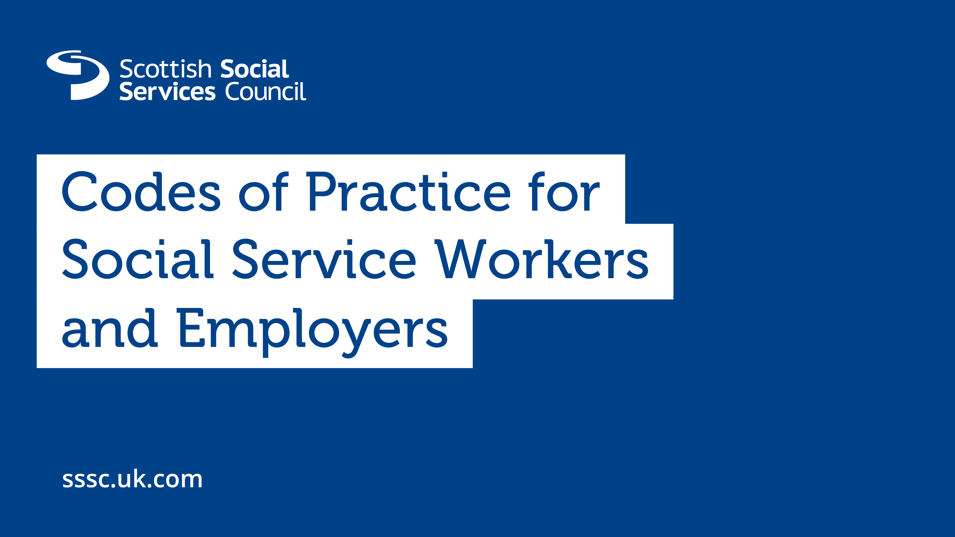
Codes of Practice for Workers and Employers Effective from 1 May 2024

Slide 16
What’s changed in the Codes?
Removed repetition and refreshed outdated language, more empowering tone and use positive language.
Clear links to the Health and Social Care Standards.
Reflect the importance of kindness, compassion and involvement in decision making.
Reflect the importance of positive relationships as well as maintaining appropriate boundaries.
New Code on working in a way that is informed by an understanding of the impact of trauma.
Strengthened the Employer Code.

Slide 17
More flexible qualifications

Slide 18
More flexible qualifications
From 3 June 2024 we’ll accept the benchmark qualifications at different levels for people moving between adult and children’s services:
SVQ Social Services (Children and Young People) for people working with adults
SVQ Social Services and Healthcare for people working with children.
People moving to a different type of service will need to complete extra CPL, for example adult or child protection.
Anyone with a qualification condition that holds one of these qualifications should contact us for advice.

Slide 19
Qualification timescales

Slide 20
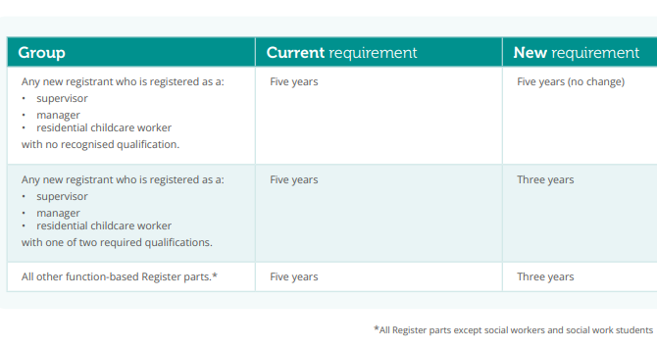
Qualification timescales
Delayed for adult social care until June 2025

Slide 21
New CPL requirements

Slide 22
New continuous professional learning (CPL) requirements
Annual declaration
Focus on key skills and knowledge required at key career stages, such as, induction, change of role, return to practice
Inclusion of core learning elements for each Register group
New requirements for newly qualified social workers (NQSW) to support the mandatory supported first year of practice from October
Flexibility for the SSSC to revise requirements to respond to emerging skills gaps
Mandatory learning on trauma and adult and child protection and for those moving from one part of the Register to another

Slide 23
Five CPL principles
My continuous professional learning (CPL):
Principle 1: is my responsibility and will be supported by my employer
Principle 2: improves the lives of, and protects, individuals and carers
Principle 3: improves the quality of care and support I provide
Principle 4: is relevant to my role and the outcomes of the individuals I support
Principle 5: supports my career, increases my confidence and improves my professional practice.

Slide 24
What’s in the new CPL?
CPL is based on four groups; social workers (including NQSW), the social care workforce, the children and young people workforce and Care Inspectorate inspectors.
There are eight pathways:
I am new to my role
I want to return to practice after a career break
I want to complete a professional qualification
I want to keep my practice up to date
I want to specialise
I want to change jobs
I want to retire
I want to take a career break.
Additionally for social work
I am a newly qualified social worker

Slide 25
Seven core learning elements
The social care and children and young people workforce will need to cover seven core learning elements:
rights based and ethical practice
communication and relationships
wellbeing and support
protection
knowledge for your role
reflective practice
leadership and quality assurance.
Trauma awareness and adult and child protection
will be mandatory for all.

Slide 26
Eight core learning elements for social workers and Care Inspectorate inspectors
ethics, values and rights-based practice
communication, engagement and relationship-based professional practice
critical thinking, professional judgement and decision making
promoting wellbeing, support and protection
working with complexity in unpredictable and ambiguous contexts
use of knowledge, research and evidence in practice
self-awareness and reflexivity
professional leadership.
Trauma awareness and adult and child protection
will be mandatory for all.

Slide 27
New CPL website
We’re developing a new website that will help registrants find the pathway relevant to their role and career stage.
It will provide links to freely available training and resources from organisations such as the SSSC, Care Inspectorate, Scottish Government, Iriss, NHS Education for Scotland.
Learning to meet the CPL requirement is entirely flexible and employers can specify their own organisational training.

Slide 28
Return to practice requirements for social workers

Slide 29
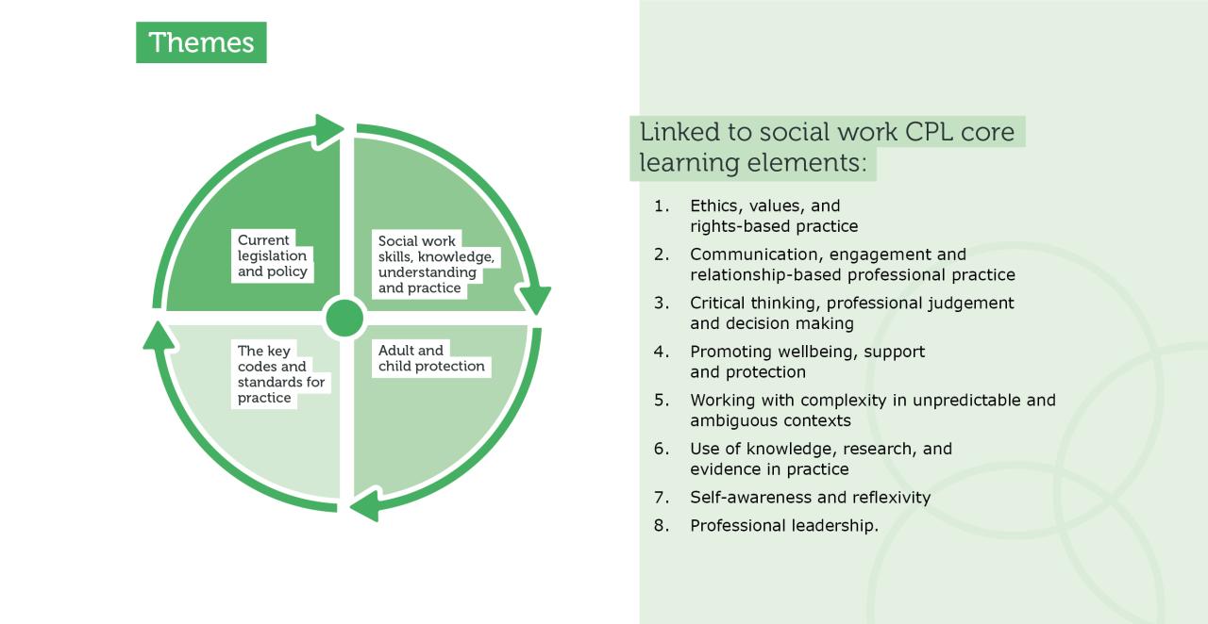
What’s required

Slide 30
A tiered approach
LENGTH OF TIME OUT OF PRACTICE | HOURS | REQUIREMENT
Less than two years | No requirement
Two to five years | 180 hours | Supervised practice: Minimum of 60 hours Formal learning: Minimum of 40 hours Informal learning: Remaining balance of hours
Over five years | 360 hours | Supervised practice: Minimum of 120 hours Formal learning: Minimum of 80 hours Informal learning: Remaining balance of hours

Slide 31
How we’ll apply return to practice requirements
If a social worker meets the return to practice requirements when they apply for registration, we will register them without a condition.
Returning social workers who do not meet the full requirements at application stage will be registered with a condition to meet the requirements within six months of re-registration.
Any learning presented as evidence towards the requirements must have been completed within the previous 12 months.

Slide 32
Key dates

Slide 33
Key dates
10 April 2024 | Last date to submit registration applications
1 May 2024 | New Codes of Practice come into effect
1 May 2024 | Last date for workers and employers to tell us about changes to employment
*29 May to 2 June | All SSSC systems will be unavailable including our phoneline
3 June 2024 | All changes come into effect**
1 June 2025 | Reducing the timescale to gain a qualification from five to three years for workers in adult services who we register with a qualification condition
*systems unavailable date to be confirmed
**delay to qualification timescale changes for adult social care until June 2025

Slide 34
Thank you
Tel: 0345 60 30 891
Web: sssc.uk.com
Email: enquiries@sssc.uk.com
Facebook @thesssc | Twitter @SSSCnews | YouTube @sssctv

